Slide 1
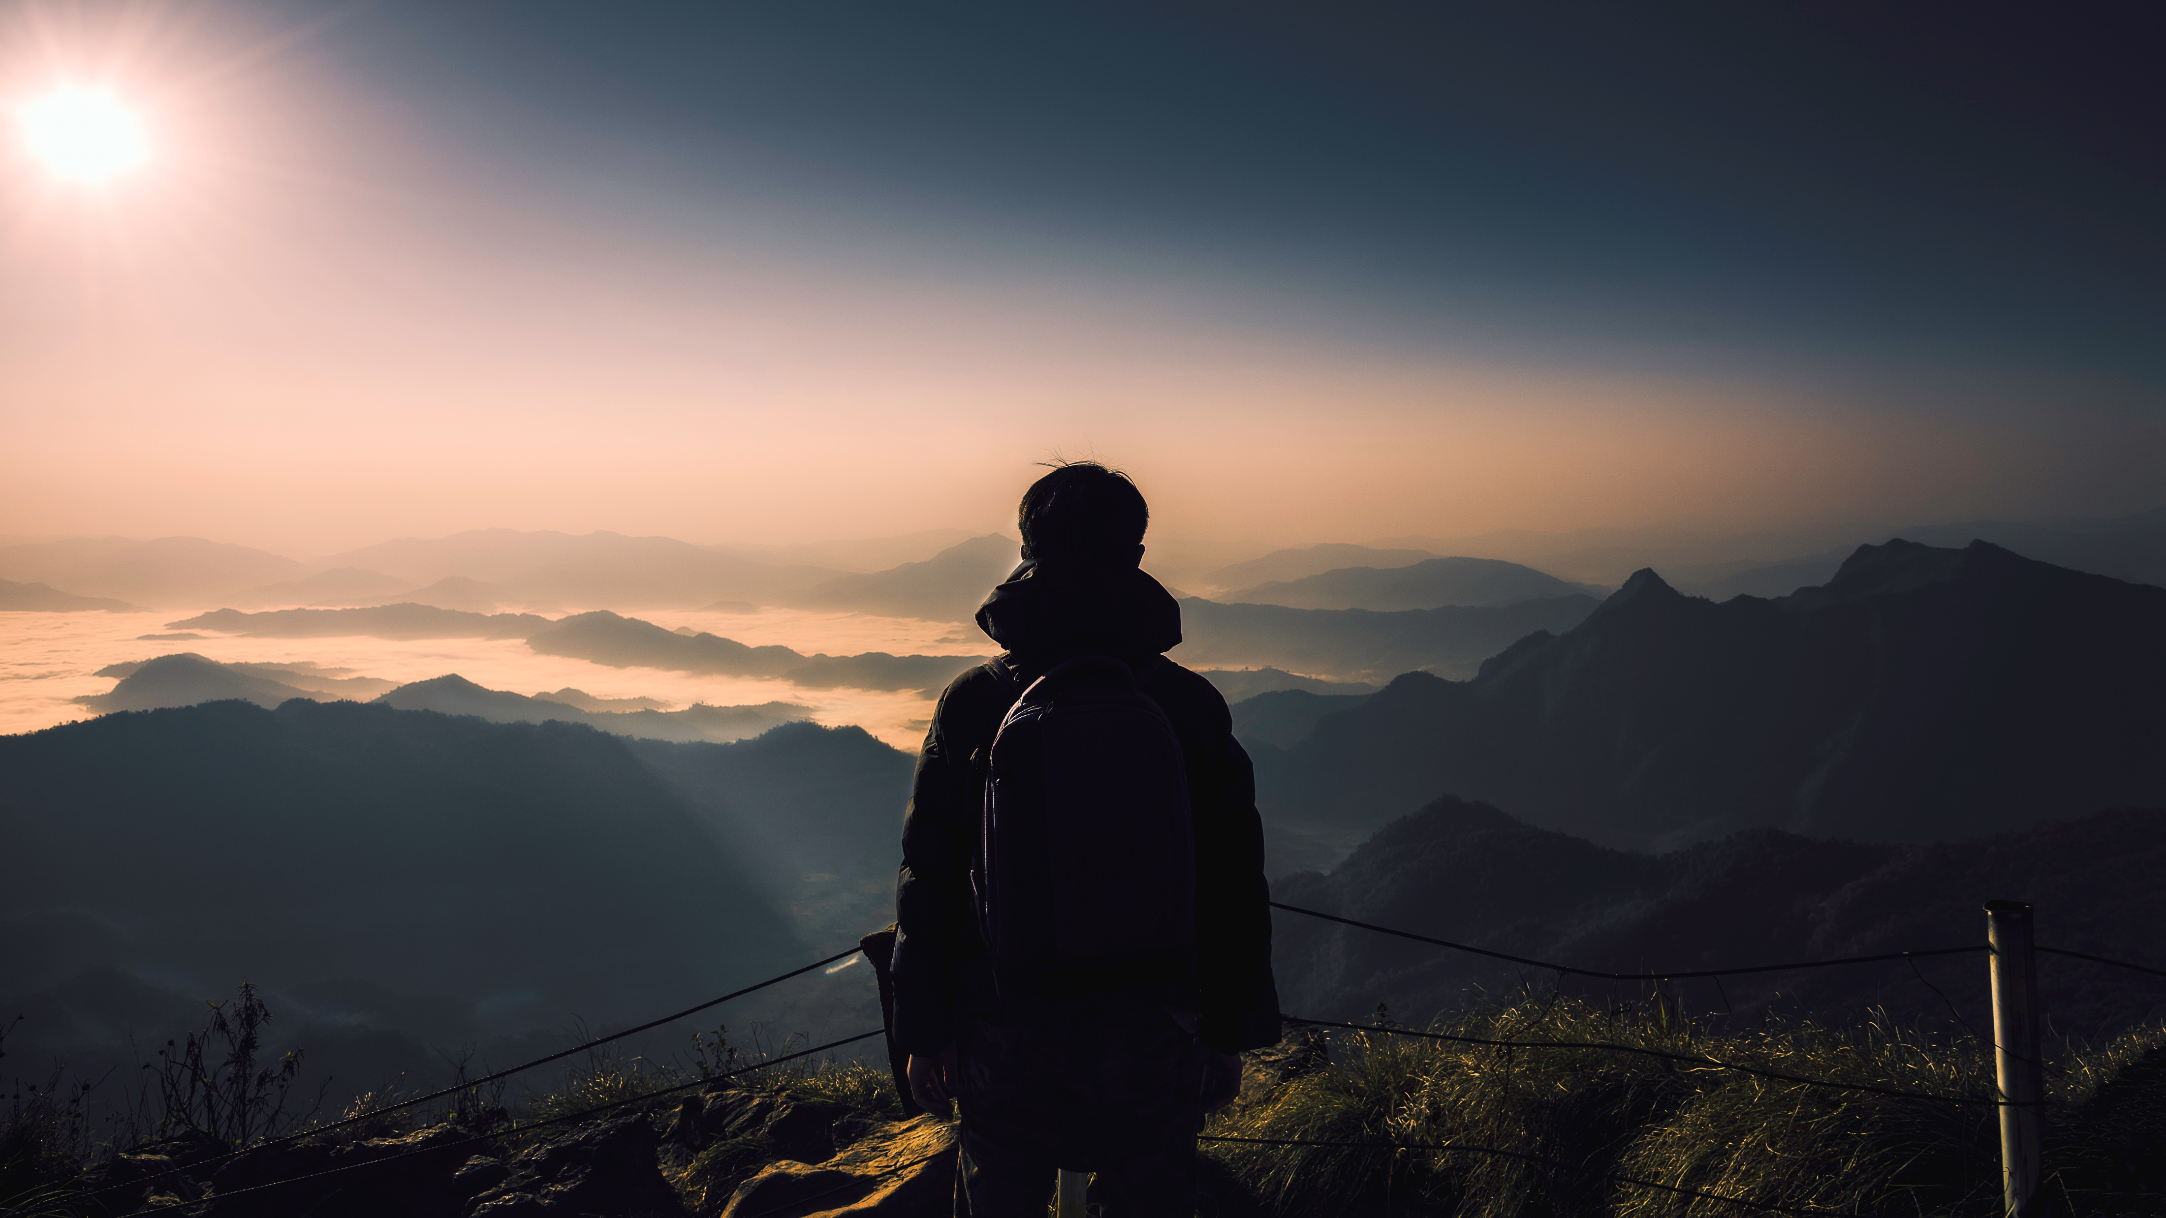
Incredible india
Indian tour Guide:
The better way to enjoy your world

Slide 2

guide
Reduce and Eliminate Expenses
Decide on a Location
Set Goals and Create a Plan

Slide 3
Common Travel Seasons in india

Slide 4



Make a Plan to visit india!
Set a destination and/or travel theme
1
Set travel dates, mode of travel, and find accommodations
2
Find local attractions, food venues, and activities
3

Slide 5
Introduction
Hello and welcome to this presentation on Indian tourism. India is a land of diverse cultures, traditions, languages, and landscapes. From the majestic Himalayas in the north to the tropical beaches in the south, India has something to offer for everyone.

Slide 6
Historical and Cultural Heritage
India has a rich historical and cultural heritage that dates back thousands of years. The country is home to some of the world's most iconic landmarks such as the Taj Mahal, the Red Fort, and the Khajuraho temples. These monuments are not only a testament to India's glorious past but also attract millions of tourists every year.

Slide 7
Adventure Tourism
For adventure seekers, India offers a plethora of activities such as trekking, mountaineering, white-water rafting, and skiing. The mighty Himalayas provide the perfect backdrop for these activities, and there are several adventure sports destinations in the country that cater to these needs.

Slide 8
conclusion
In conclusion, India is a land of contrasts and diversity, and its tourism offerings reflect that. Whether you're looking for historical landmarks, natural beauty, adventure sports, spiritual experiences, or medical facilities, India has something for everyone. We hope you enjoyed this presentation and consider visiting India for your next vacation. Thank you for your time.

Slide 9

Thank you
viewers

